Slide 1
Multiple Linear regression
Notes:
This template can be used as a starter file for presenting training materials in a group setting.
Sections
Sections can help to organize your slides or facilitate collaboration between multiple authors. On the Home tab under Slides, click Section, and then click Add Section.
Notes
Use the Notes pane for delivery notes or to provide additional details for the audience. You can see these notes in Presenter View during your presentation.
Keep in mind the font size (important for accessibility, visibility, videotaping, and online production)
Coordinated colors
Pay particular attention to the graphs, charts, and text boxes.
Consider that attendees will print in black and white or grayscale. Run a test print to make sure your colors work when printed in pure black and white and grayscale.
Graphics, tables, and graphs
Keep it simple: If possible, use consistent, non-distracting styles and colors.
Label all graphs and tables.

Slide 2

Example: What determine an NBA player’s salary?
The data contain salary of 68 NBA players for their 2016 contracts and some key statistics associated with each of these players including assists per game (APG), points per game (PPG), rebounds per game (RPG), and steals per game (SPG). Denote the four predictors by X1, X2, X3, X4. Let Y be the log(Salary).

Slide 3
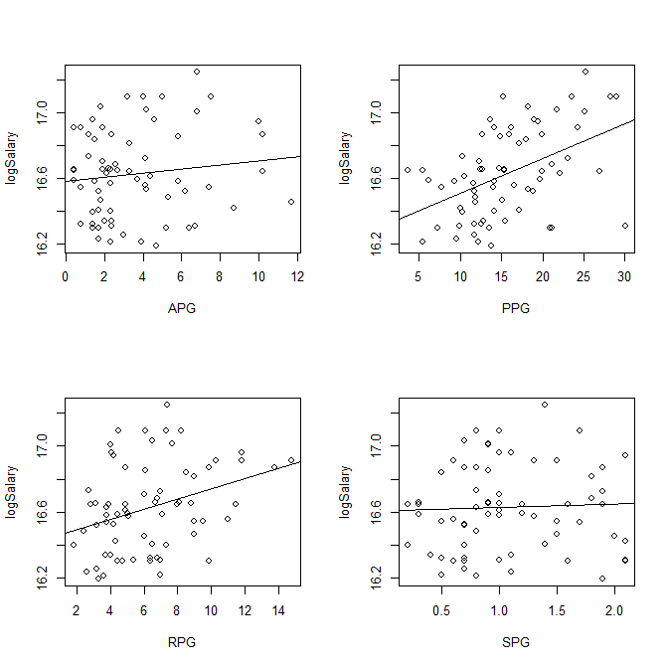

Slide 4
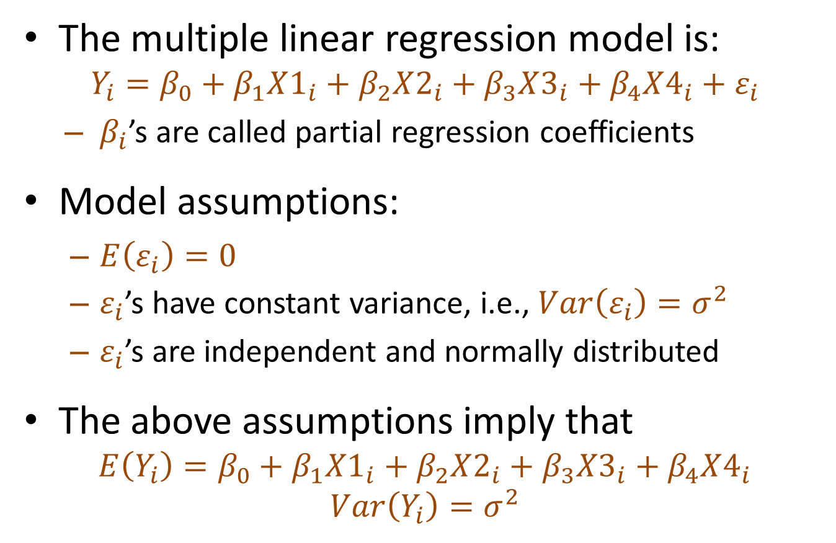
Model Formulation
The multiple linear regression model is:
$$Y_{i}=β_{0}+β_{1}X1_{i}+β_{2}X2_{i}+β_{3}X3_{i}+β_{4}X4_{i}+ε_{i}$$
  $β_{i}$’s are called partial regression coefficients
Model assumptions:
  $E\left(ε_{i}\right)=0$
  $ε_{i}$’s have constant variance, i.e., $Var\left(ε_{i}\right)=σ^{2}$
  $ε_{i}$’s are independent and normally distributed
The above assumptions imply that
$$E\left(Y_{i}\right)=β_{0}+β_{1}X1_{i}+β_{2}X2_{i}+β_{3}X3_{i}+β_{4}X4_{i}$$
$$Var\left(Y_{i}\right)=σ^{2}$$

Slide 5
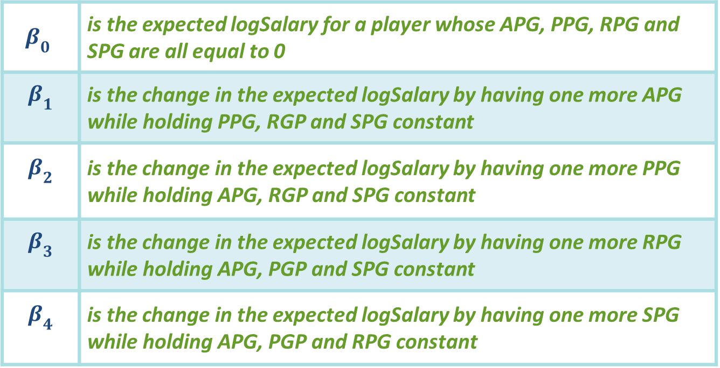
Interpretation of the regression coefficients
$β_{0}$ | is the expected logSalary for a player whose APG, PPG, RPG and SPG are all equal to 0
$$β_{1}$$ | is the change in the expected logSalary by having one more APG while holding PPG, RGP and SPG constant
$$β_{2}$$ | is the change in the expected logSalary by having one more PPG while holding APG, RGP and SPG constant
$$β_{3}$$ | is the change in the expected logSalary by having one more RPG while holding APG, PGP and SPG constant
$$β_{4}$$ | is the change in the expected logSalary by having one more SPG while holding APG, PGP and RPG constant

Slide 6
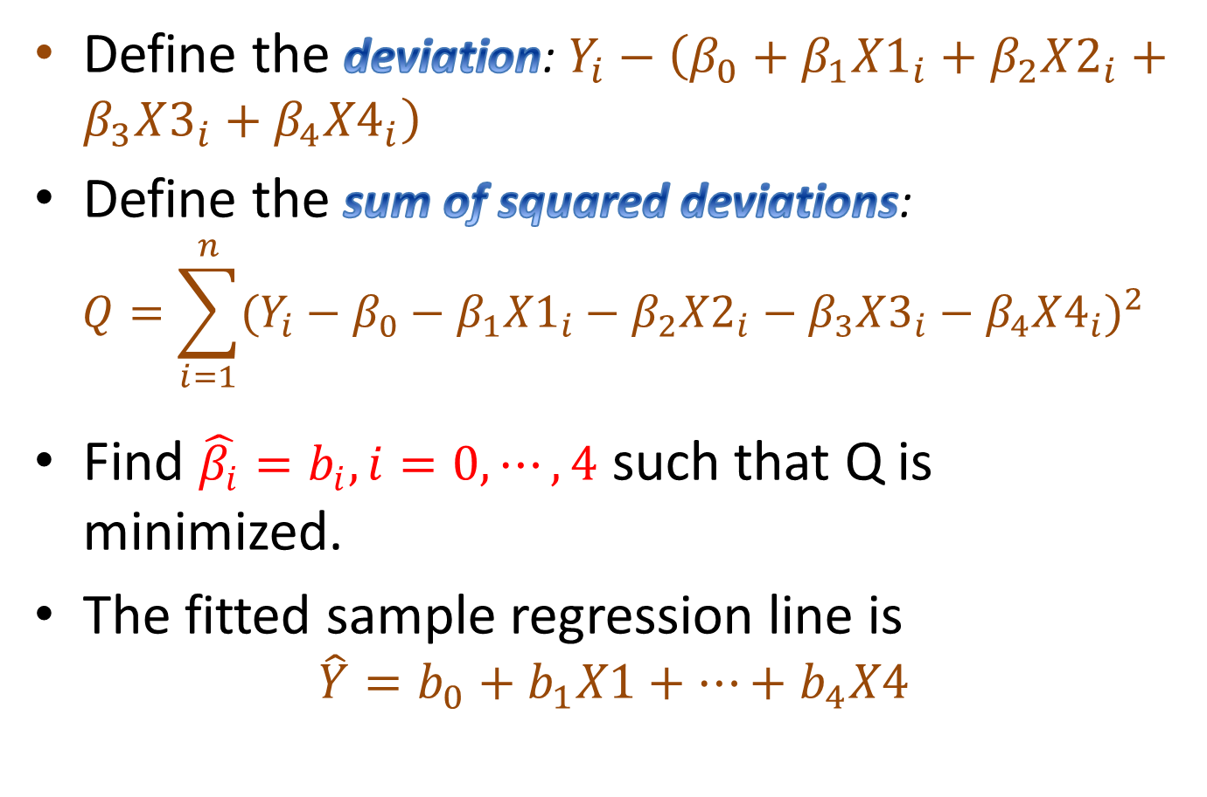
The Method of Least Squares
Define the deviation: $Y_{i}−\left(β_{0}+β_{1}{X1}_{i}+β_{2}X2_{i}+β_{3}X3_{i}+β_{4}{X4}_{i}\right)$
Define the sum of squared deviations:
$$Q=\sum_{i=1}^{n}{{(Y_{i}−β_{0}−β_{1}{X1}_{i}−β_{2}X2_{i}−β_{3}X3_{i}−β_{4}X4_{i})}^{2}}$$
Find $\hat{β_{i}}=b_{i}, i=0,⋯,4$ such that Q is minimized.
The fitted sample regression line is
$$\hat{Y}=b_{0}+b_{1}X1+⋯+b_{4}X4$$

Slide 7

Example: What determine a NBA player’s salary?
Write out the sample regression line and interpret the regression coefficients

Slide 8
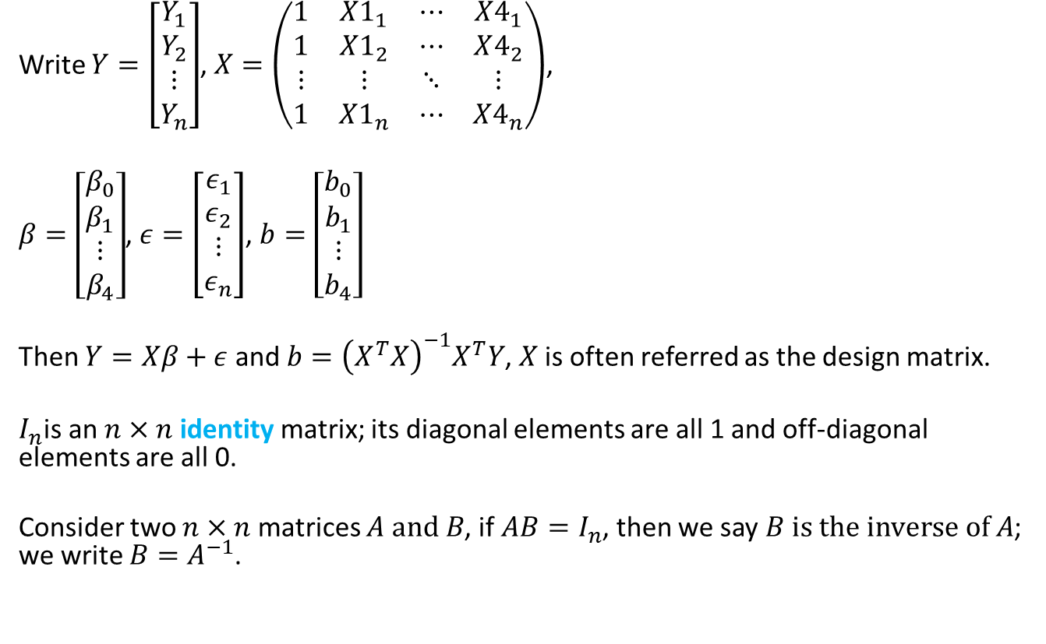
Matrix Representation
Write $Y=\left[\begin{matrix}Y_{1} \\ Y_{2} \\ \begin{aligned}⋮ \\ Y_{n}\end{aligned}\end{matrix}\right]$, $X=\left(\begin{matrix}1 & X1_{1} & ⋯ & X4_{1} \\ 1 & X1_{2} & ⋯ & X4_{2} \\ ⋮ & ⋮ & ⋱ & ⋮ \\ 1 & X1_{n} & ⋯ & X4_{n}\end{matrix}\right)$,
$β=\left[\begin{matrix}β_{0} \\ β_{1} \\ \begin{aligned}⋮ \\ β_{4}\end{aligned}\end{matrix}\right]$, $ε=\left[\begin{matrix}ε_{1} \\ ε_{2} \\ \begin{aligned}⋮ \\ ε_{n}\end{aligned}\end{matrix}\right]$, $b=\left[\begin{matrix}b_{0} \\ b_{1} \\ \begin{aligned}⋮ \\ b_{4}\end{aligned}\end{matrix}\right]$
Then $Y=Xβ+ε$ and $b={\left(X^{T}X\right)}^{−1}X^{T}Y$, $X$ is often referred as the design matrix.
$I_{n}$is an $n×n$ identity matrix; its diagonal elements are all 1 and off-diagonal elements are all 0.
Consider two $n×n$ matrices $A and B$, if $AB=I_{n}$, then we say $B is the inverse of A$; we write $B=A^{−1}$.

Slide 9
Things to look at
How can the model help explain the variability in the data (ANOVA)?
What can we say about the regression coefficients (confidence intervals, hypothesis testing)?
How do we obtain confidence and prediction intervals for the response?
Does the fitted model fit the data well? Are any model assumptions being violated (residual diagnostics)?
If there is a problem, what do we do (transformations etc)?
How do we determine a “good” model?

Slide 10
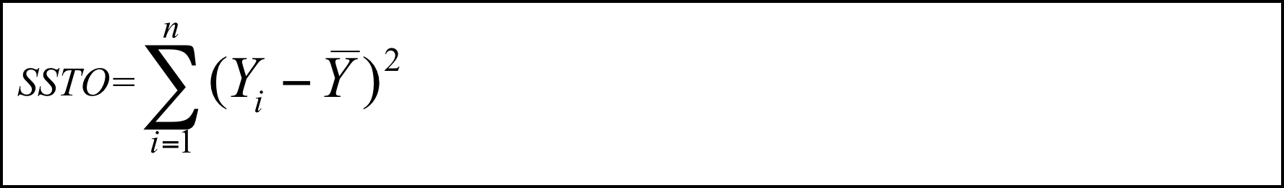

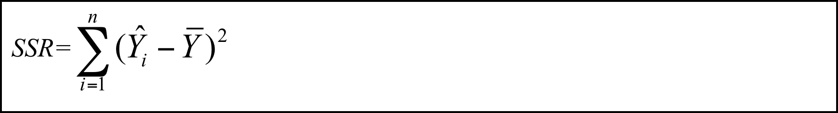
ANOVA – partitioning of squares
Sum of squared total
Sum of squared error
Sum of squared regression

Slide 11
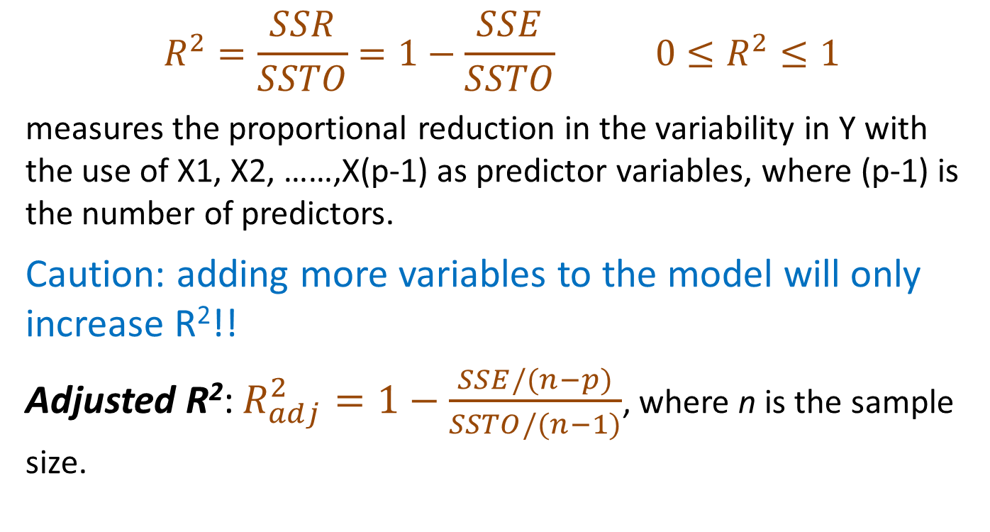
The Coefficient of Multiple Determination
$$R^{2}=\frac{SSR}{SSTO}=1−\frac{SSE}{SSTO} 0≤R^{2}≤1$$
measures the proportional reduction in the variability in Y with the use of X1, X2, ……,X(p-1) as predictor variables, where (p-1) is the number of predictors.
Caution: adding more variables to the model will only increase R²!!
Adjusted R²: $R_{adj}^{2}=1−\frac{SSE/(n−p)}{SSTO/(n−1)}$, where n is the sample size.

Slide 12
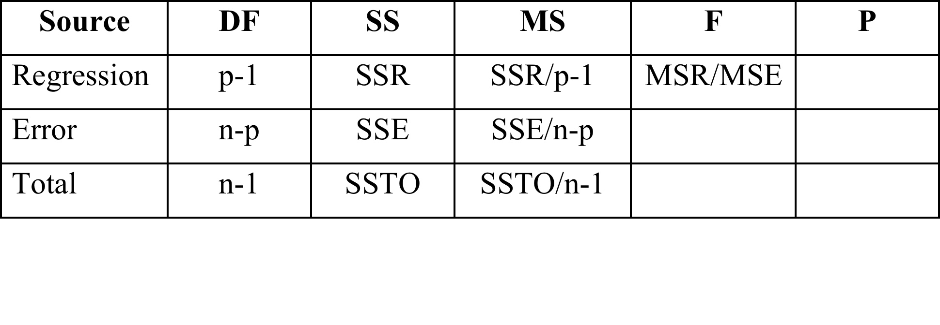
ANOVA Table

Slide 13
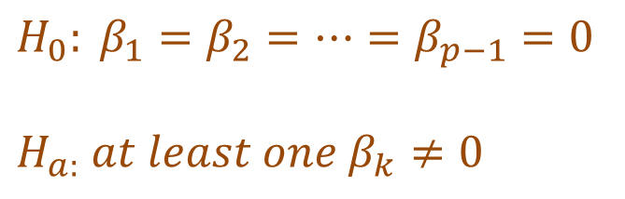
We use this F statistic to test the overall regression relationship.
Rejects for large F statistics as quantified by the p-value. If the p-value is less than the level of significance, then reject, otherwise do not reject.
Note: If you reject in multiple linear regression, you do not know which or how many are not zero. You only know that at least one is not zero.
$$H_{0}: β_{1}=β_{2}=…=β_{p−1}=0$$
$$H_{a:} at least one β_{k}≠0$$

Slide 14
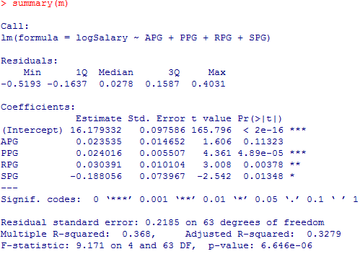
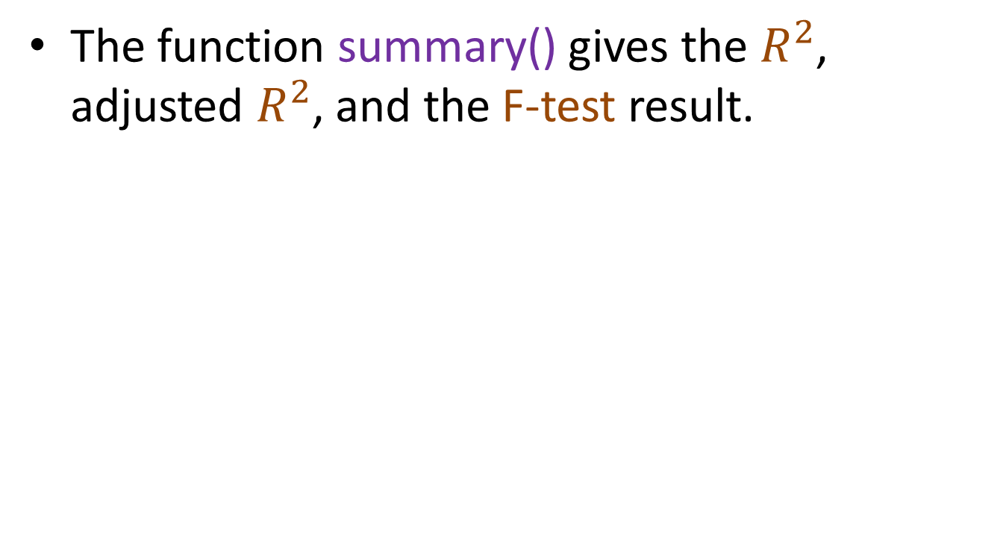
Example: What determine an NBA player’s salary?
The function summary() gives the $R^{2}$, adjusted $R^{2}$, and the F-test result.

Slide 15
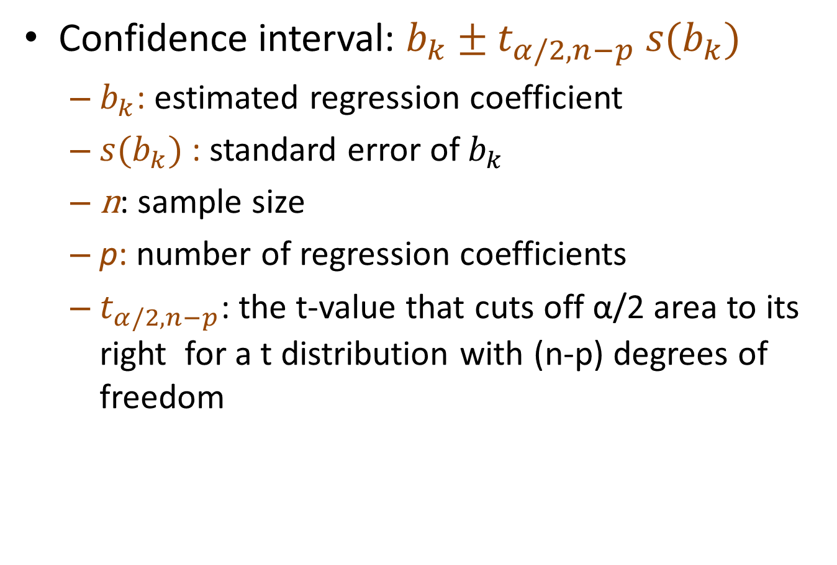

Inference about $β_{k}$: confidence interval
Confidence interval: $b_{k}±t_{α/2,n−p} s(b_{k})$
  $b_{k}$: estimated regression coefficient
  $s(b_{k})$: standard error of $b_{k}$
  n: sample size
  p: number of regression coefficients
  $t_{α/2,n−p}$: the t-value that cuts off α/2 area to its right for a t distribution with (n-p) degrees of freedom

Slide 16
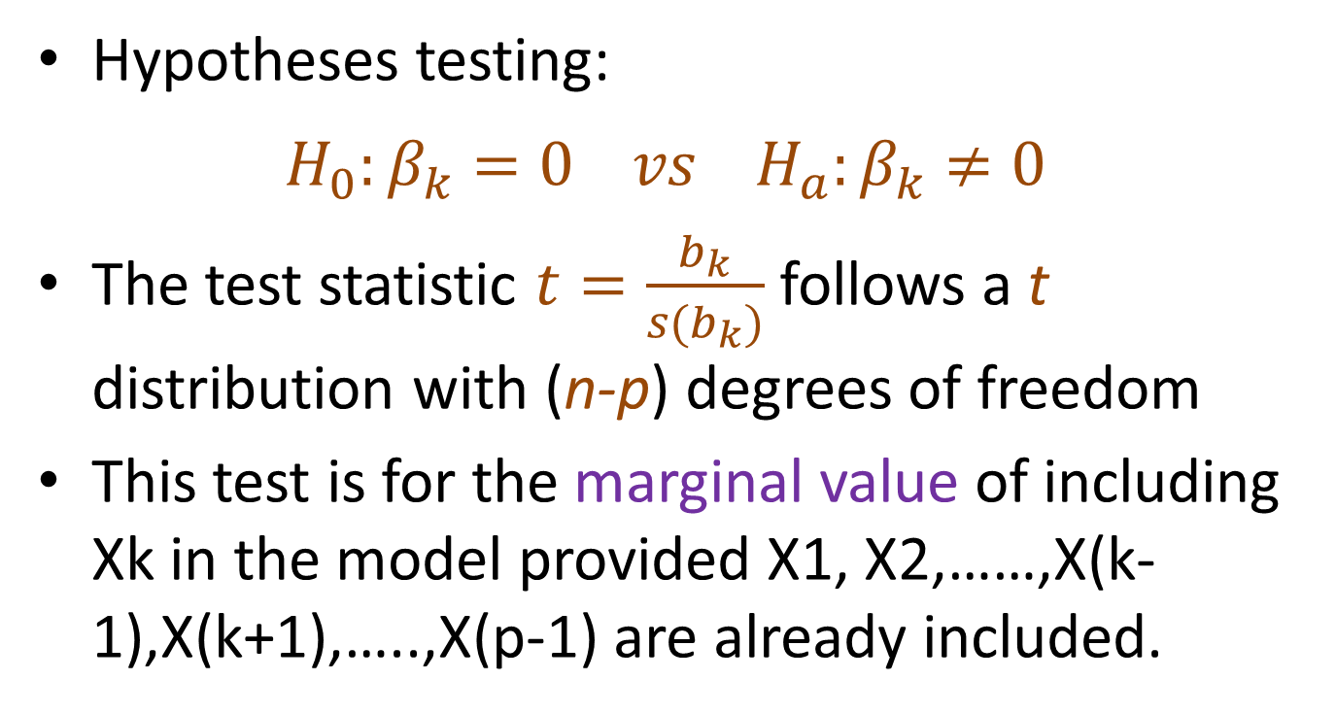

Inference about $β_{k}$: hypothesis testing
Hypotheses testing:
$$H_{0}:β_{k}=0 vs H_{a}:β_{k}≠0$$
The test statistic $t=\frac{b_{k}}{s(b_{k})}$ follows a t distribution with (n-p) degrees of freedom
This test is for the marginal value of including Xk in the model provided X1, X2,……,X(k-1),X(k+1),…..,X(p-1) are already included.

Slide 17
If you reject, you are concluding that Xk does provide additional explanatory value given the other variables are already included.
If you fail to reject you are concluding that Xk does not provide additional explanatory value given the other variables are included in the model.
If the p-value is smaller than the level of significance, reject H₀ , otherwise fail to reject H₀ .

Slide 18
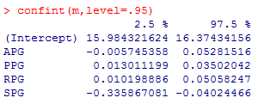
Example: What determine an NBA player’s salary?
Obtain and interpret the 95% confidence intervals for the regression coefficients.

Slide 19
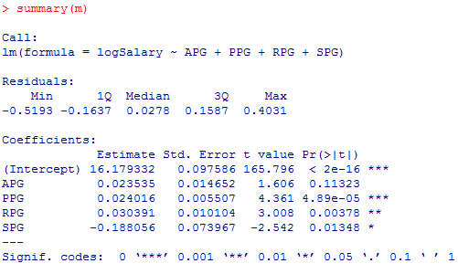
Test whether the regression coefficients are significantly different from zero. Interpret your results.

Slide 20
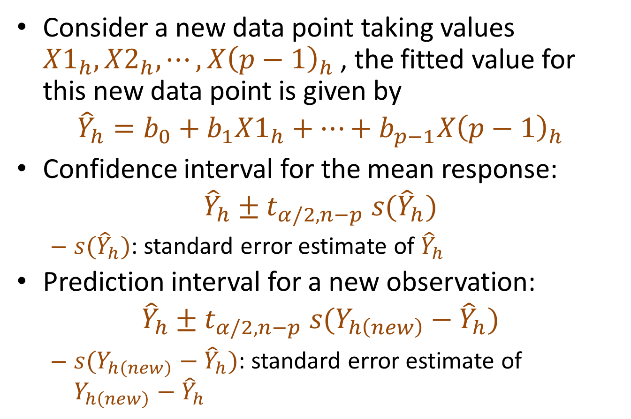
Confidence and prediction intervals
Consider a new data point taking values ${X1}_{h}, X2_{h}, ⋯,X{\left(p−1\right)}_{h}$, the fitted value for this new data point is given by
$${\hat{Y}}_{h}=b_{0}+b_{1}X1_{h}+⋯+b_{p−1}X{\left(p−1\right)}_{h}$$
Confidence interval for the mean response:
$${\hat{Y}}_{h}±t_{α/2,n−p} s({\hat{Y}}_{h})$$
  $s({\hat{Y}}_{h})$: standard error estimate of ${\hat{Y}}_{h}$
Prediction interval for a new observation:
$${\hat{Y}}_{h}±t_{α/2,n−p} s(Y_{h\left(new\right)}−{\hat{Y}}_{h})$$
  $s(Y_{h\left(new\right)}−{\hat{Y}}_{h})$: standard error estimate of $Y_{h\left(new\right)}−{\hat{Y}}_{h}$

Slide 21

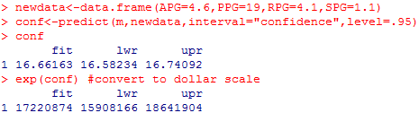
Example: What determine an NBA player’s salary?
Dwyane Wade’s 2015 statistics were
Estimate the average Salary for a player with the same performance statistics.

Slide 22
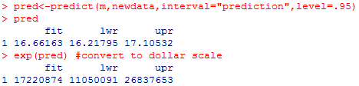
Obtain a prediction interval for the actual Salary for a player with the same statistics.
Dwyane Wade’s actual Salary for 2016 is 23,200,000. Do you think that he got a good contract? The Heat initially offered him 10,000,000 for the 2016. Would that have been a fair offer based on his past performance?

Slide 23
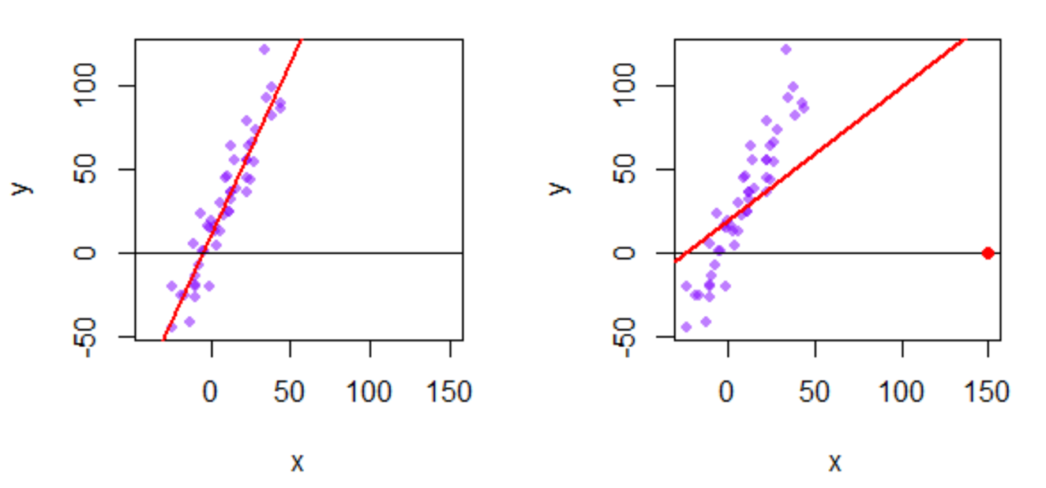
Diagnostics about the predictors
Each data point tries to pull the sample regression line towards itself.
Points with extreme predictor values (e.g. the red point in 2nd graph) have more leverage.
How to find such points with many predictors?

Slide 24
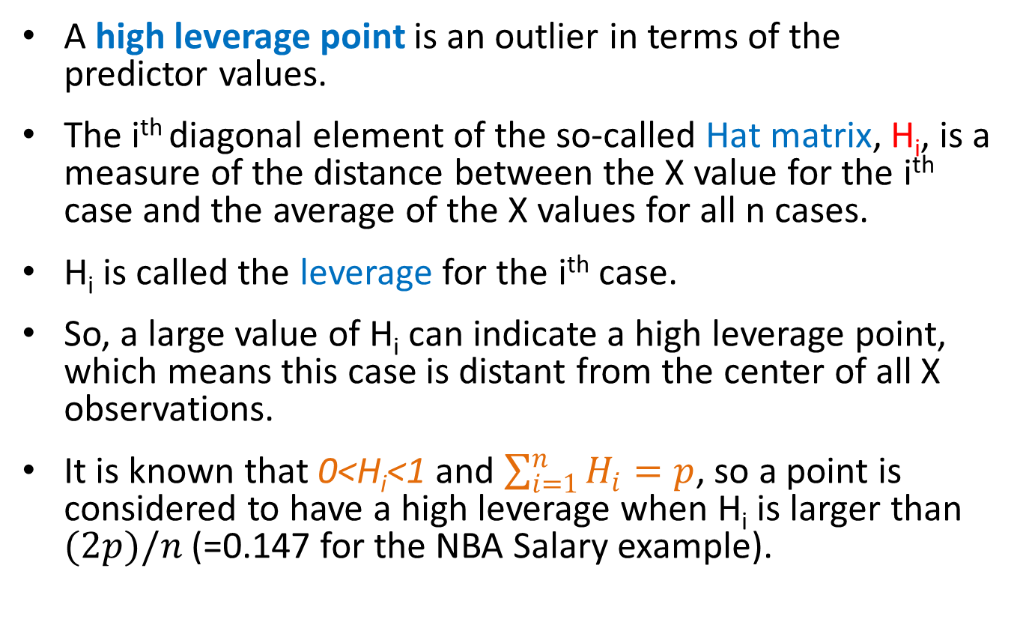
Diagnostics about the predictors
A high leverage point is an outlier in terms of the predictor values.
The i^{th} diagonal element of the so-called Hat matrix, H_{i}, is a measure of the distance between the X value for the i^{th} case and the average of the X values for all n cases.
H_{i} is called the leverage for the i^{th} case.
So, a large value of H_{i} can indicate a high leverage point, which means this case is distant from the center of all X observations.
It is known that 0<H_{i}<1 and $\sum_{i=1}^{n}{H_{i}=p}$, so a point is considered to have a high leverage when H_{i} is larger than $(2p)/n$ (=0.147 for the NBA Salary example).

Slide 25

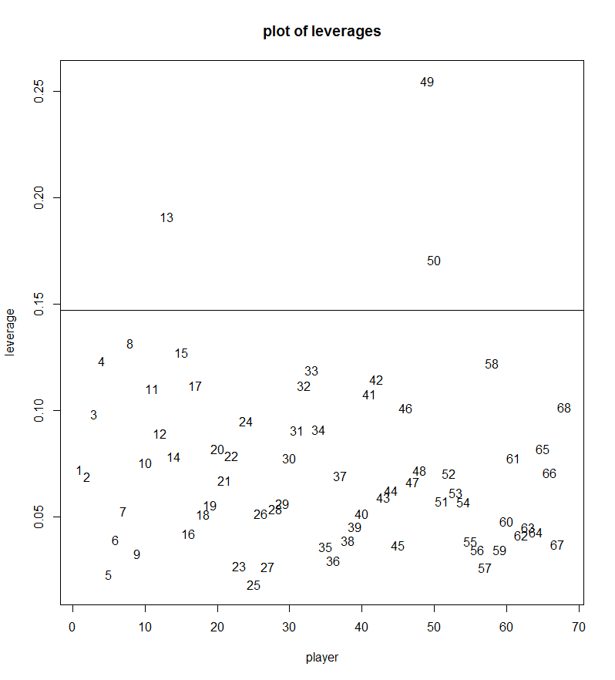


Slide 26

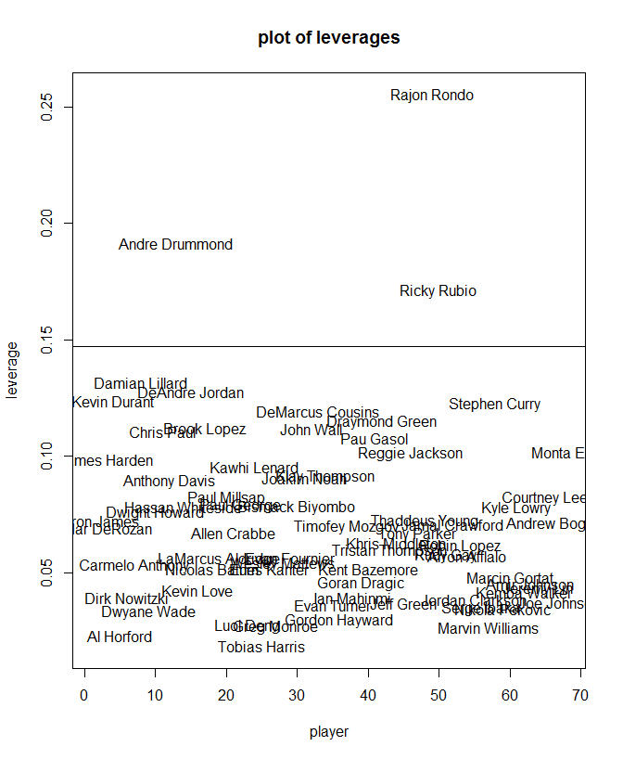

Slide 27
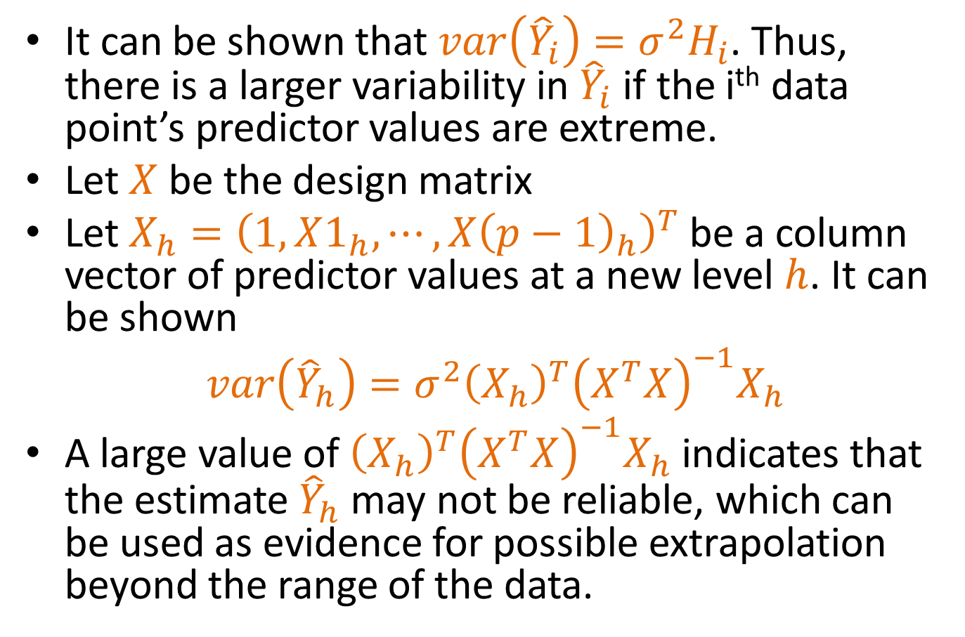
Detect Extrapolation Beyond the Range of the Data (not required)
It can be shown that ${var\left({\hat{Y}}_{i}\right)=σ^{2}H}_{i}$. Thus, there is a larger variability in ${\hat{Y}}_{i}$ if the i^{th} data point’s predictor values are extreme.
Let $X$ be the design matrix
Let $X_{h}={\left(1,X1_{h},⋯,X{\left(p−1\right)}_{h}\right)}^{T}$ be a column vector of predictor values at a new level $h$. It can be shown
$var\left({\hat{Y}}_{h}\right)=σ^{2}{\left(X_{h}\right)}^{T}{\left(X^{T}X\right)}^{−1}X_{h}$
A large value of ${\left(X_{h}\right)}^{T}{\left(X^{T}X\right)}^{−1}X_{h}$ indicates that the estimate ${\hat{Y}}_{h}$ may not be reliable, which can be used as evidence for possible extrapolation beyond the range of the data.

Slide 28
Residual Diagnostics
  If the multiple linear regression model is appropriate (use Residuals vs Fitted)
  If the errors have constant variance (use Residuals vs Fitted and/or Scale-Location)
  If the errors are independent (plot residuals against time)
  If there are outliers present (use Residuals vs Fitted and/or Residuals vs Leverage)
  If the errors are normally distributed (use Normal Q-Q plot)
  If there are any influential points (use Cook’s distance)

Slide 29
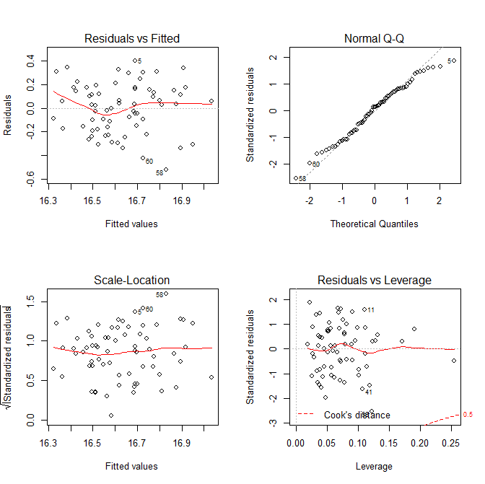

Example: What determine an NBA player’s salary?

Slide 30
Comment on whether the various model assumptions are satisfied based on the residual plots shown in the previous slide.

Slide 31

Make residual plots of your own
You can use the functions rstandard() and rstudent() in R to get the standardized and studentized deleted residuals.

Slide 32
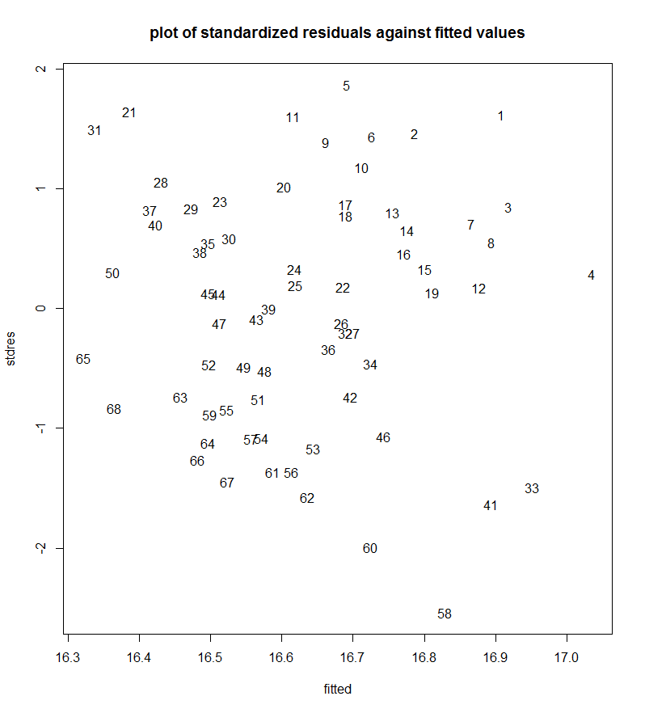


Slide 33
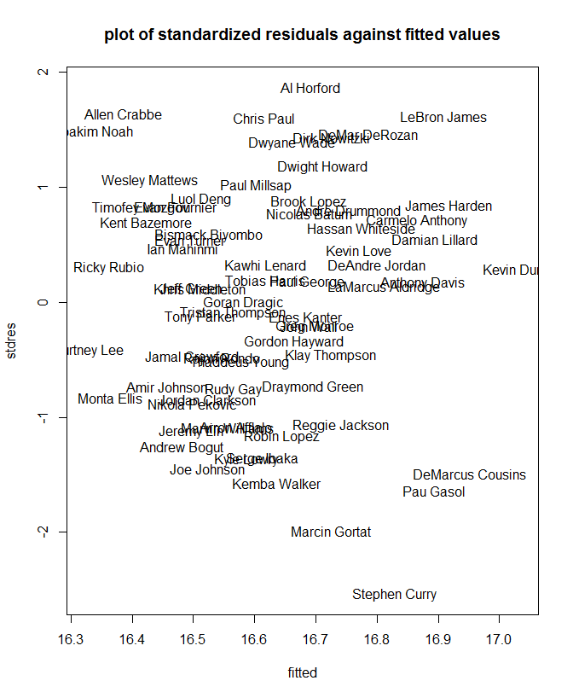

Slide 34
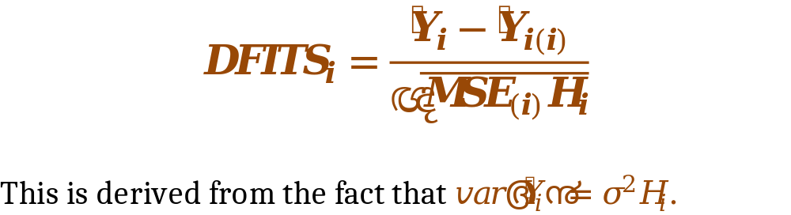
Detecting influential cases
DFITS gives differences in fitted values when the i^{th} case is deleted.
It measures the relative change in the fitted value for the i^{th} case when the i^{th} case is deleted.

Slide 35
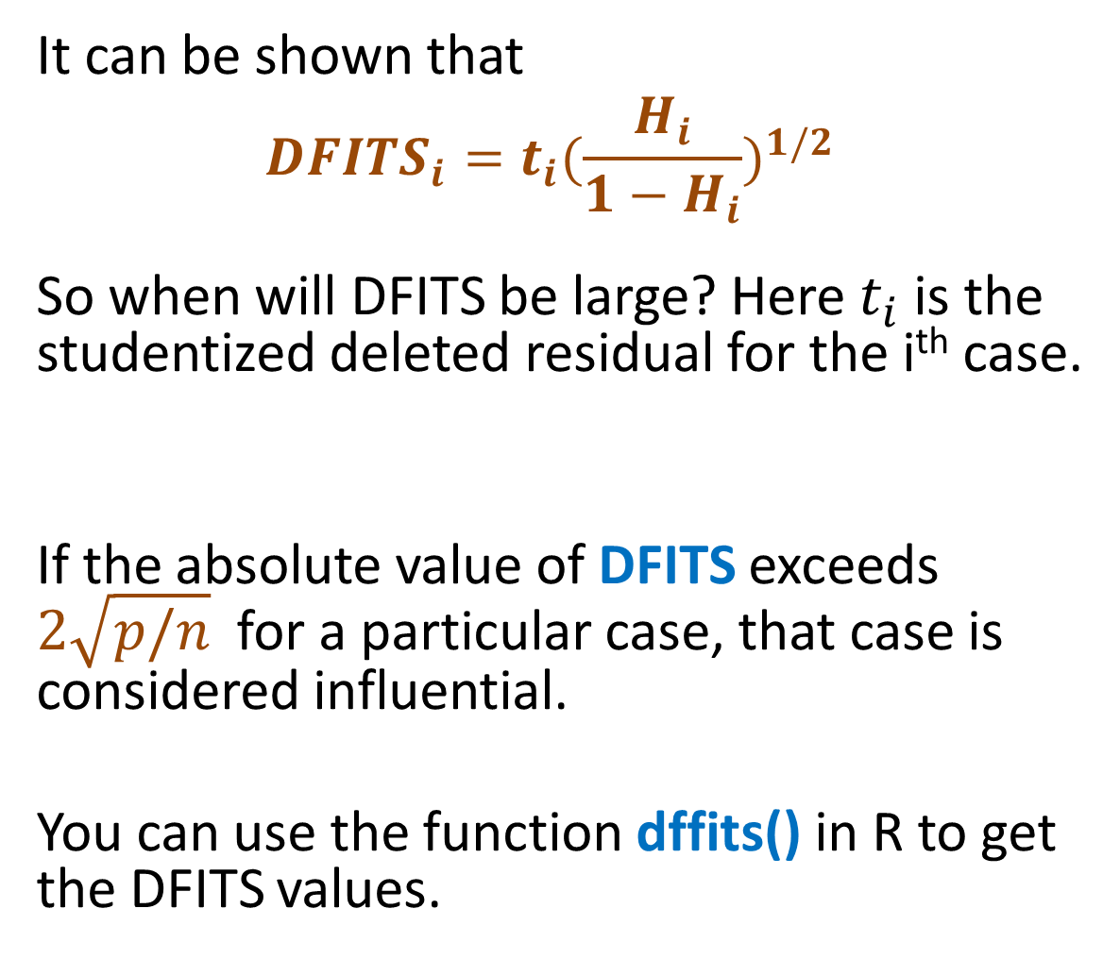
It can be shown that
$${DFITS}_{i}=t_{i}{(\frac{H_{i}}{1−H_{i}})}^{1/2}$$
So when will DFITS be large? Here $t_{i}$ is the studentized deleted residual for the i^{th} case.
If the absolute value of DFITS exceeds $2\sqrt{p/n}$ for a particular case, that case is considered influential.
You can use the function dffits() in R to get the DFITS values.

Slide 36

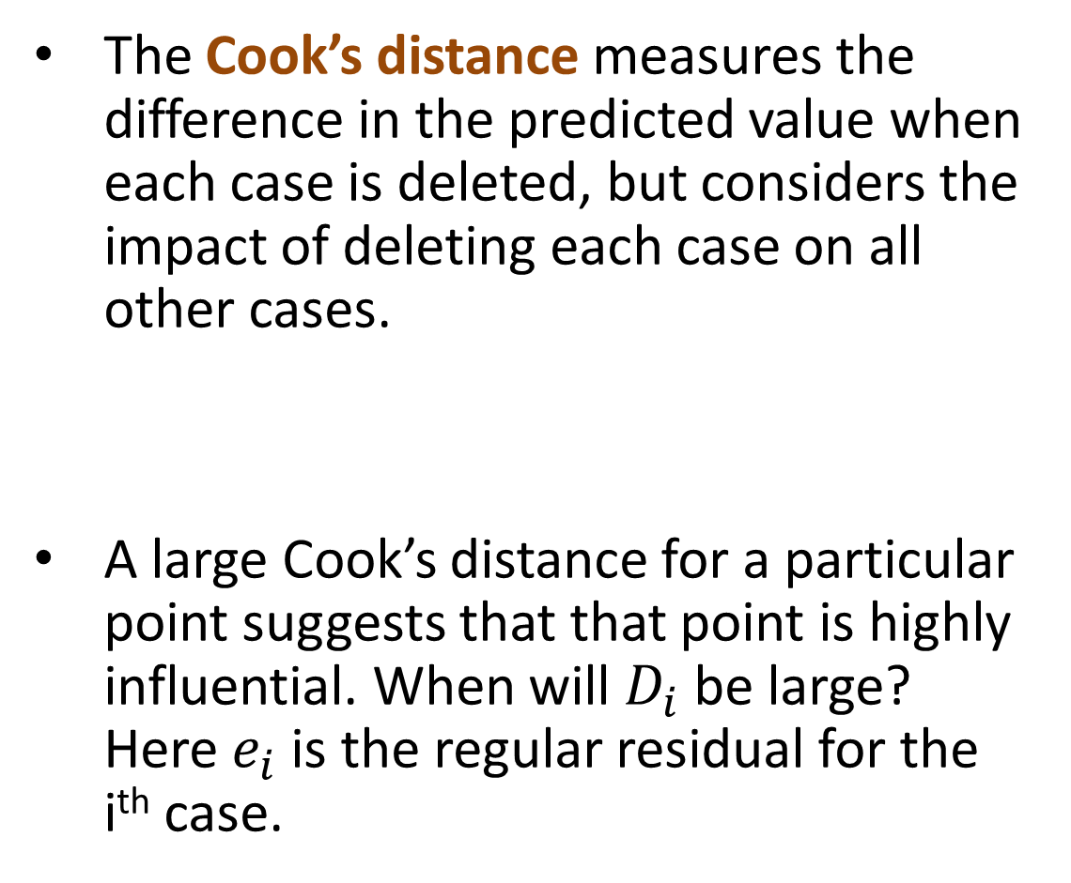
The Cook’s distance measures the difference in the predicted value when each case is deleted, but considers the impact of deleting each case on all other cases.
A large Cook’s distance for a particular point suggests that that point is highly influential. When will $D_{i}$ be large? Here $e_{i}$ is the regular residual for the i^{th} case.

Slide 37
How large is large enough?
Compare it to the F(p,n-p) distribution: if the corresponding percentile is less than about 10 or 20 percent, then the point has little influence; if the percentile is near 50 percent or more, then there is high influence.
The best thing to do is to determine if the Cook’s distance is large relative to the other n-1 Cook’s distances for that sample. A value with a Cook’s distance that is large relative to the other n-1 Cook’s distances is considered highly influential.

Slide 38

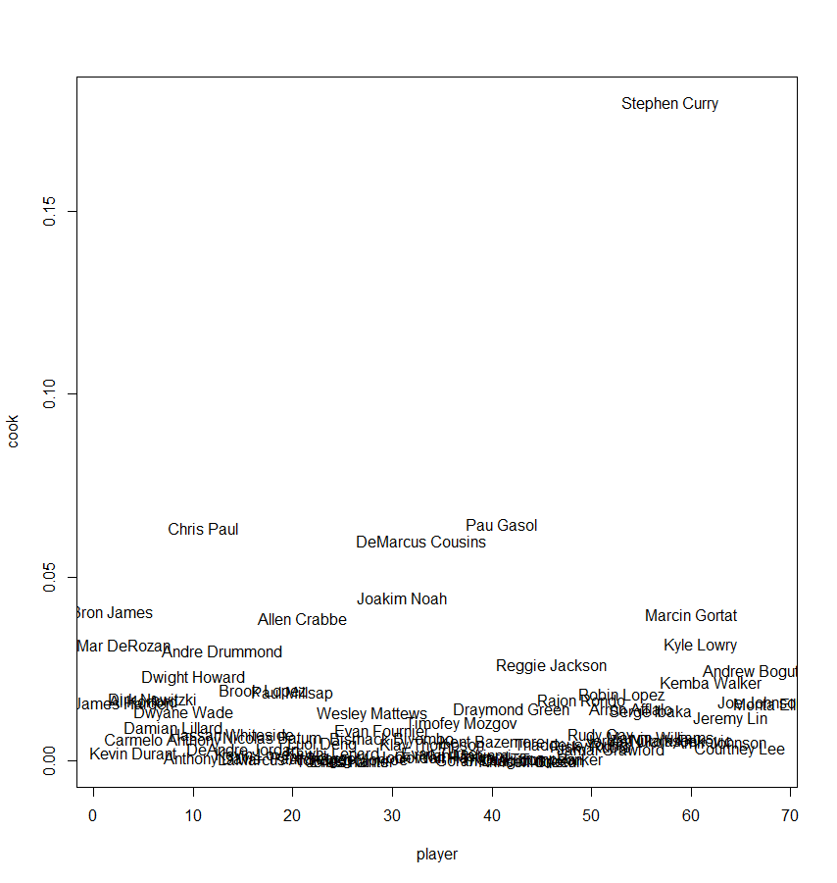

Slide 39

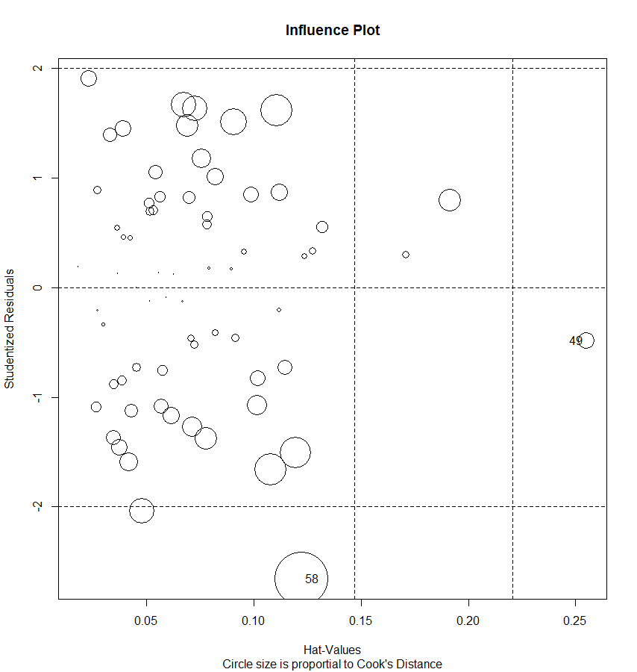



Slide 40
The function influencePlot() creates a “bubble” plot of Studentized residuals by hat values, with the areas of the circles representing the observations proportional to Cook's distances.
Vertical reference lines are drawn at twice and three times the average hat value.
Horizontal reference lines at -2, 0, and 2 on the Studentized-residual scale.

Slide 41
